Slide 1


CS-429 Introduction to Data Science
Fall 2024

Slide 2
Lecture outline
What is Spam Emails?
Why LR wont work for spam filtering?
Naïve Bayes
Examples of Naïve Bayes
Spam filter for individual and combined words
Laplace smoothing
Comparing Naïve Bayes and k-NN

Slide 3
Spam Emails

Slide 4
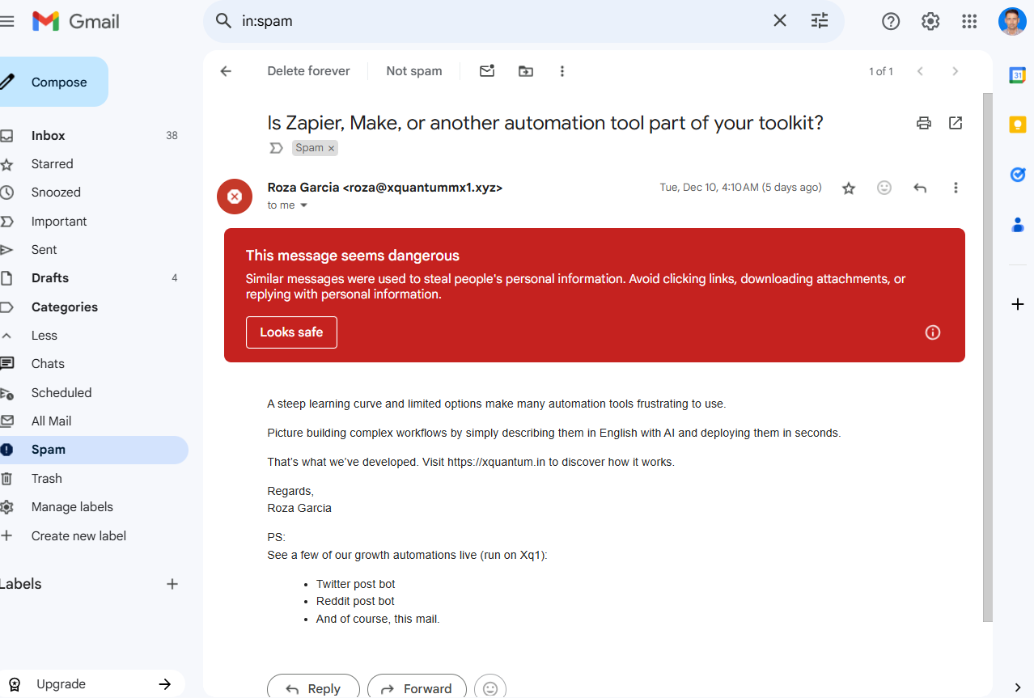
Spam Folder

Slide 5
What is Spam Filtering?
Spam filtering is identifying and classifying unwanted messages, commonly known as “spam”, and prevents them from covering a user’s email inbox.
This mechanism ensures that legitimate emails are delivered while separating potential spam emails into a spam/junk folder.
Spam emails often include:
Advertisements for products or services.
Phishing attempts (to steal personal information).
Malware distribution.
Unsolicited offers or scams.

Slide 6
Benefits of Spam Filtering
Protection from Phishing and Scams: Prevents emails designed to steal sensitive information like passwords or bank details.
Reduced Clutter: Keeps the inbox organized and free from irrelevant emails.
Enhanced Productivity: Saves time by reducing the need to manually sort through spam.
Malware Protection: Reduces the likelihood of malicious links or attachments infecting a user’s system.
Improved Security: Safeguards personal and corporate data from external threats.

Slide 7
How is Spam Filtering Implemented?
Spam filtering uses techniques, including rule-based systems and machine learning algorithms, to analyse and classify emails.
The general outline:
Feature Extraction: Key characteristics of an email (features) are analysed, such as:
Sender’s email address and domain.
Subject line (e.g., excessive use of uppercase, promotional phrases, exclamation points, or other punctuations).
Content (e.g., certain keywords like “Win”, “Free”, or “Discount”).
Presence of links or attachments.
Header metadata.

Slide 8
How is Spam Filtering Implemented?
Classification Methods:
Rule-based Filtering: Predefined rules, such as filtering emails from specific domains or with certain keywords, are applied.
Machine Learning Algorithms:
Bayesian Spam Filtering: Uses probabilistic models to calculate the likelihood of an email being spam.
Support Vector Machines (SVMs): Separates spam and legitimate emails using statistical models.
Neural Networks: Learn patterns in spam emails for better accuracy.

Slide 9
Why not the Linear Regression?
Spam Detection is a Classification Problem: Spam filtering involves assigning emails to one of two discrete categories: “spam” or “not spam”. This makes it a classification problem.
Linear regression tries to predict numbers, not categories. Spam filtering needs a method that can clearly say if an email belongs to one group or the other.
Linear regression predicts values on a continuous scale, potentially outside the valid range for probabilities (0 to 1). For example, the model could output values like -0.2 or 1.5, which do not make sense in the context of spam detection.

Slide 10
Why not the Linear Regression?
Spam detection is tricky because the rules for what makes an email spam are often not simple or straight lines, but linear regression assumes they are.
Methods, like Logistic Regression, Decision Trees, SVM, or Bayesian filters, are much better at understanding these kinds of problems (Spam filtering) and making accurate decisions.

Slide 11
Why not the KNN?
KNN looks at emails it has seen before and checks which ones are most similar to the new email. If most of the similar emails were spam, it will label the new email as spam too.
KNN has some problems with spam filtering:
Slow with Big Data: Spam filters deal with tons of emails, and KNN needs to compare a new email with all the past emails. This can take a lot of time.
Storage Requirement: KNN has to keep all the data it uses for comparison, which means it needs a lot of storage.
No Learning: KNN doesn’t really “learn” from the data. It just stores it and uses it for future comparisons.

Slide 12
Datasets for Spam Filtering
SpamAssassin Public Corpus: SpamAssassin public corpus
Enron Email Dataset: The Enron Email Dataset (1.43GB)
LingSpam Dataset: Ling-Spam Dataset
TREC 2007 Spam Corpus: Preprocessed TREC 2007 Public Corpus Dataset
SMS Spam Collection Dataset: SMS Spam Collection Dataset

Slide 13
Naïve Bayes

Slide 14
Naïve Bayes
Naive Bayes is a simple but powerful algorithm used for classification tasks.
It is based on Bayes’ Theorem, which calculates probabilities for events based on prior knowledge of conditions related to the event.
This algorithm is called “naïve” because it assumes that all features are independent of each other, which is rarely true in real-world data but simplifies calculations and works surprisingly well in practice.

Slide 15
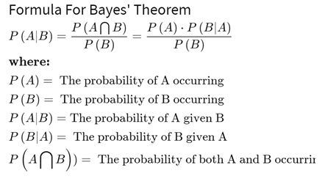
Bayes Theorem

Slide 16
Example of Naïve Bayes
You have a dataset of emails with two classes: Spam or Ham (not Spam). Suppose we consider the words “free”, “offer”, and “win” as features.
Email | Class | Free | Offer | Win
Email 1 | Spam | Yes | Yes | Yes
Email 2 | Spam | Yes | No | No
Email 3 | Ham | Yes | No | No
Email 4 | Ham | No | Yes | No

Slide 17
Email | Class | Free | Offer | Win
Email 1 | Spam | Yes | Yes | Yes
Email 2 | Spam | Yes | No | No
Email 3 | Ham | Yes | No | No
Email 4 | Ham | No | Yes | No
Example of Naïve Bayes
Step 1: Calculate Probabilities

Slide 18
Email | Class | Free | Offer | Win
Email 1 | Spam | Yes | Yes | Yes
Email 2 | Spam | Yes | No | No
Email 3 | Ham | Yes | No | No
Email 4 | Ham | No | Yes | No
Example of Naïve Bayes
Step 1: Calculate Probabilities

Slide 19
Email | Class | Free | Offer | Win
Email 1 | Spam | Yes | Yes | Yes
Email 2 | Spam | Yes | No | No
Email 3 | Ham | Yes | No | No
Email 4 | Ham | No | Yes | No
Example of Naïve Bayes
Step 2: Apply Bayes’ Formula
The probability of Spam is higher than Ham. Therefore, classify the email as Spam.

Slide 20
Benefits of Naïve Bayes
Fast and Efficient: Works well for large datasets and real-time applications.
Simple and Interpretable: Easy to implement and understand.
Good for Text Classification: Particularly effective for spam filtering, sentiment analysis, etc.

Slide 21
Limitation of Naïve Bayes
Strong Independence Assumption: Assumes features are independent, which is not always true.
Zero-Frequency Problem: If a feature value is not present in the training data for a class, its probability becomes zero. (This can be mitigated using smoothing techniques like Laplace Smoothing.)
Poor with Continuous Data: Struggles with continuous numerical features without preprocessing or binning.

Slide 22
Example 2 of Naïve Bayes
Suppose we have an employee’s email account.
Total emails are 5172: in which 1500 are spam emails and 3,672 are ham (not spam) emails.
Let’s consider word “meeting”, whose count in spam emails is 16 and 153 in ham emails
Now compute the chance that an email is spam only knowing it contains the word “meeting”:

Slide 23
Example 2 of Naïve Bayes
Total emails = 5172
spam emails = 1500
ham (not spam) emails = 3,672
word “meeting”,
in spam emails = 16
in ham emails = 153

Slide 24
Example 2 of Naïve Bayes
Total emails = 5172
spam emails = 1500
ham (not spam) emails = 3,672
word “meeting”,
in spam emails = 16
in ham emails = 153

Slide 25
Laplace Correction/Smoothing
Laplace Correction, also known as Laplace Smoothing, is a technique used in Naïve Bayes to handle the problem of zero probabilities.
This issue arises when a particular word or feature in the dataset has not been seen in the training data for a specific class.
Without smoothing, such a scenario can make the entire probability computation for that class equal to zero.

Slide 26


Slide 27

THE SECRET || LAW OF ATTRACTION (Audio: Hindi )
URL: THE SECRET || LAW OF ATTRACTION || HINDI VERSION || #mindset#reality
Total Duration: 01:30 Hrs

